Slide 1

SHREE RAMSWAROOP MEMORIAL UNIVERSITY
Assignment:-1
Java Enterprise Edition Lab - 01
Submitted to:
Submitted by:
Vidushi Srivastava
Mukesh Prajapati
Btech (Cse Industry integrated)
Roll No – 202410101230007

Slide 2
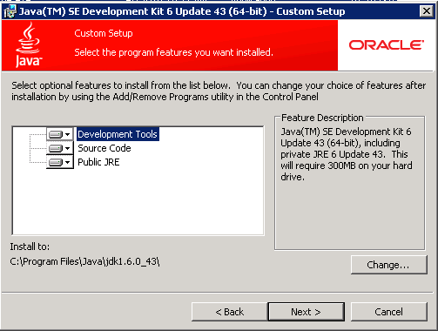
Ç 1. JDK (Java Development Kit) Installation
Caption: This screenshot shows the setup window for Java SE Development Kit being installed on the system.

Slide 3
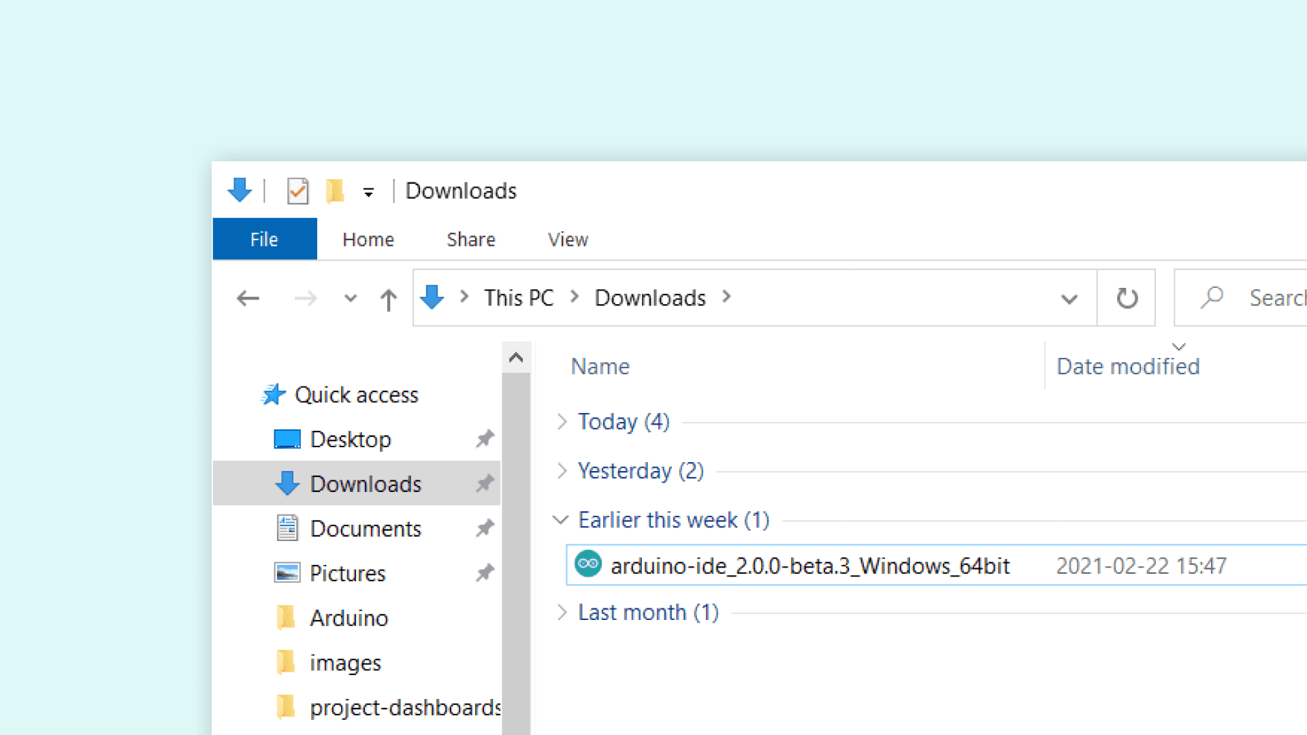
2. Downloading the IDE Installer
The screenshot displays the downloaded IDE setup file stored in the Downloads folder.

Slide 4
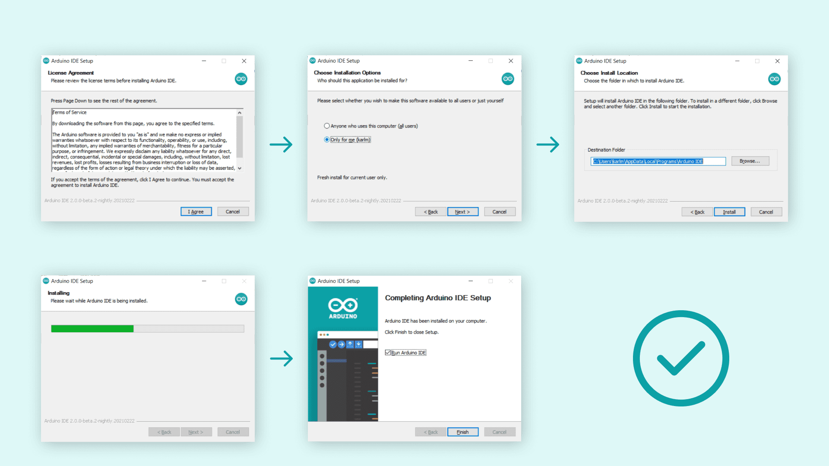
3.Installation Process of IDE (Eclipse/IntelliJ)
The screenshots demonstrate the step-by-step installation procedure of the selected IDE.

Slide 5
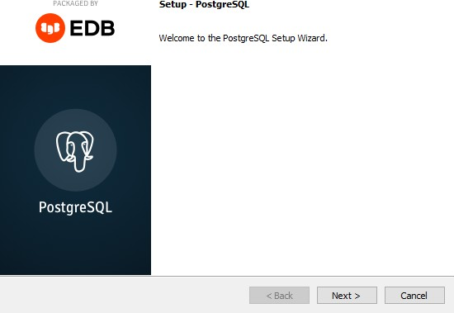
4. Beginning PostgreSQL Installation Setup
The PostgreSQL setup wizard is launched to start the installation process.

Slide 6
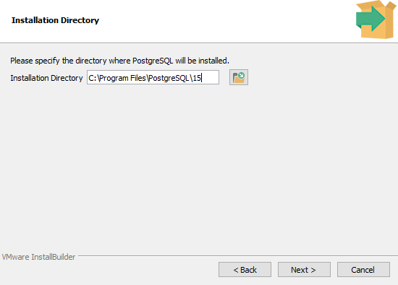
5. PostgreSQL Installation Directory Configuration
The directory path is set for PostgreSQL installation in the system.

Slide 7
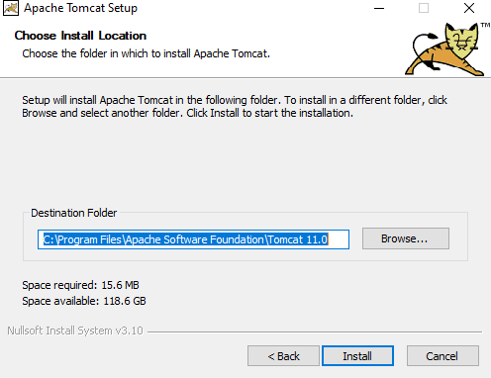
6.Apache Tomcat Installation Configuration

Slide 8
The setup window shows the installation path for Apache Tomcat web server before starting installation.

